Slide 1
Attendance Management System

Slide 2
Team Members
Amanjeet Singh - 1401051085
Deepanshu Joshi – 1401051077
Ashish Singh Panwar - 1401051034
Under the Guidance of
Dr. Narendra Kumar
Faculty, Department of Information Technology, DIT University.

Slide 3
Objective
To remove the use of pen and paper means for taking the attendance.
To reduce the malpractices of faking someone’s presence.
To avoid marking of backdate attendance.
To provide a cost efficient alternative.

Slide 4
Attendance Management System
As the name suggests, Attendance Management System is an application that makes it an ease to update attendance on one end and view the same on the other.
It works on the concept of time clocks.

Slide 5
Introduction
Attendance Management System is a user-friendly, and fully featured student attendance management application.
It captures data from Time and Attendance Terminals, and simultaneously allows optional PC entry.
Automatically calculates attendance percentage, total classes attended and unattended classes for a particular student.

Slide 6
Enables performing some key administrative functions such as tracking absences, getting debar list, etc.
It eliminates the need of keeping attendance records on paper, or on spreadsheets.
Moreover, one will not have to apply formulae to separately calculate percentages.

Slide 7
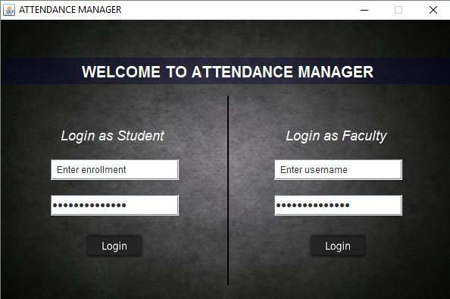
Attendance Management System
(User Interface)

Slide 8
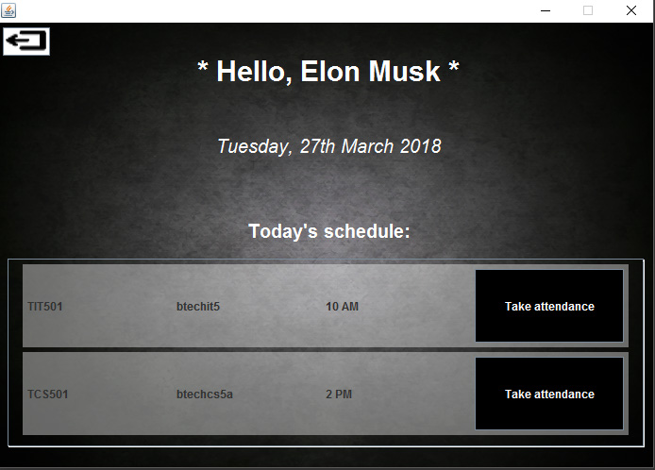
Teacher’s View

Slide 9
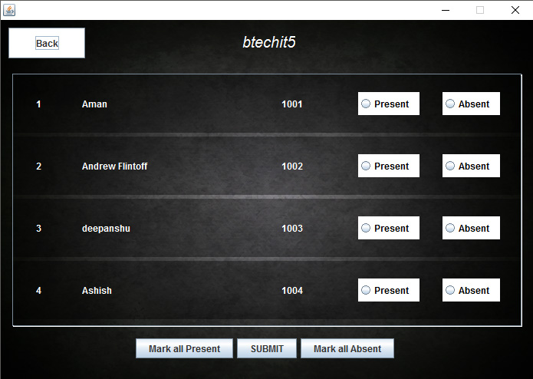
Student roll of the class selected

Slide 10
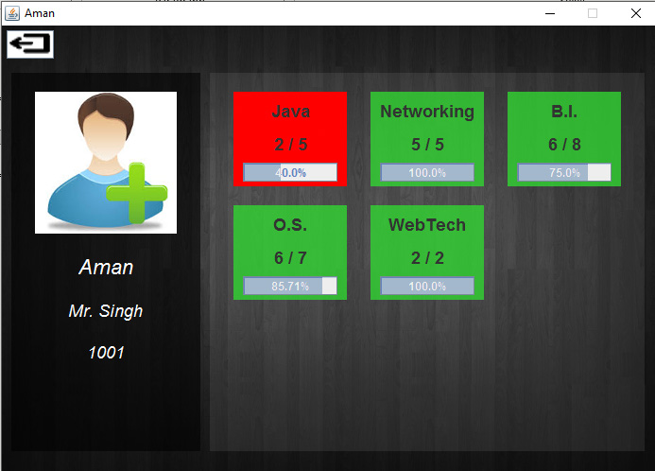
Student’s View

Slide 11
Importance
It can be used in institutions with low finance.
It will make the use of pen-n-paper technique obsolete.
It can work easily in minimum requirements.
It Doesn’t require much maintaince.

Slide 12
Methodology
The main methodology behind the project is to use a java application in the front end along with a server hosting tool like WAMP server in the back end to allow faculties to maintain attendance of students in an easy manner, and view it on the student end so they can keep a record of it with the help of a proper interface.

Slide 13
Phase I
Information gathering.
Building basic structure of the project on paper.
Installing the tools required to build the project.
Created the basic interface.

Slide 14
Phase II
Backend development.
Enhancing the UI.
Connecting the backend using JDBC MySQL Drivers.
Testing the project.
Building the test database.
Generation of Project Report.

Slide 15
Outcome
The traditional method could easily allow for impersonation and the attendance sheet could be stolen or lost. In paper attendance, it is difficult to ascertain the number of students that have made the minimum percentage and thus eligible for exam. Thus, there is a need for a system that would eliminate all of these trouble spots.

Slide 16
References
1. Herbert Schildt, JAVA: The Complete Reference, Oracle Press, 2004
2. E. Balagurusamy, Programming with JAVA, McGraw Hill Pvt. Ltd., Delhi, 2015
3. Stack Overflow, http://stackoverflow.com/.
4. W3Schools Online Web Tutorials, W3schools.com.
5. Head First Java by Kathy Sierra and Bert Bates, 1st Edition, O Reilly Media, 2005.
6. MySQL Cookbook by Paul DuBois, 3rd Edition, O Reilly Media, 2014.

Slide 17
Thank You !

